Slide 1
Burn Mass Casualty and Burn Surge Disaster Preparedness Course
Burn Surge Disaster Plan Development, Key considerations developing a burn surge strategy for your Organization
September 2021

Slide 2
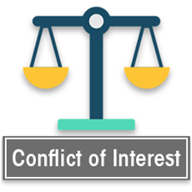
Disclosures
In relation to this presentation, I declare that there are no conflicts of interest and, no off-label use of medications will be discussed
The content of this work focuses on general surge topics is based in part on the research of Hick & Hanfling et al. Terrorism, burn and blast trauma injury information is based on the research of Peleg et al. The burn surge content is based on the research of Kearns et al. Academic sources are included at the end of the presentation.
Cases selected for demonstration are based on either personal experiences or extensive research of the event
Medical care discussed in this content represents information commonly found in current academic sources at the time it was developed. All medical care and medical practice should be reviewed by a physician for currency and accuracy
A conflict of interest is any situation in which a speaker or immediate family members have interests, and those may cause a conflict with the current presentation. Conflicts of interest do not preclude the delivery of the talk, but should be explicitly declared. These may include financial interests (eg. owning stocks of a related company, having received honoraria, consultancy fees), research interests (research support by grants or otherwise), organisational interests and gifts.

Slide 3
Recap
By this point, we have reviewed the Science of Surge Capacity, examples of what can produce a Burn Mass Casualty Incident (BMCI) and Burn Triage.

Slide 4
Recap cont.
This section will take components of those works and discuss in the context of surge planning.
Much of a BMCI preparedness and planning, relies on existing MCI preparedness and planning efforts.

Slide 5
Why do we plan? Is Strategy Important?
Plans put into words, our initial actions during a disaster or mass casualty incident
The strategic value of planning includes creating repetition, muscle memory

Slide 6
Why do we plan? Is Strategy Important? Cont.
In the chaos of a disaster, plans remind us of what we can do and trigger points for when we need help.
In the chaos of a disaster, plans remind us of our thoughts we had before the fog of war

Slide 7
Why do we plan? Is Strategy Important? Cont.
Planning for a Burn Mass Casualty Incident (BMCI) initially looks like most MCI planning.

Slide 8
Building a Plan, Starts with the Basics
Disaster plans should be an extension of what you do every day. The more you abandon the path of what you do every day for a unique procedure during a disaster, the more likely that procedure will fail (muscle memory)

Slide 9
Building a Plan, Starts with the Basics cont.
If you intend to use triage tags, they should be frequently used aside from the rare mass casualty incident. For some of the best systems, this can be expensive. Are there cost effective alternatives?

Slide 10
Building a Plan, Starts with the Basics cont.
Who are your mutual aid partners? How often do you work with them? Train with them? Participate in off duty activities? (do you trust them?)

Slide 11
Building a Plan, Starts with the Basics cont.
All disasters are local. After the disaster in your community is over, mutual aid will return home, but it is still your community.

Slide 12
Plans and Extension of Daily Activities
Any mass casualty incident will include multiple responses. How much effort do you make to control the scene for daily 9-1-1 calls? Staging of vehicles, access and egress?

Slide 13
Plans and Extension of Daily Activities cont.
On daily 9-1-1 calls, (when possible) do you reposition the ambulance, pointed to the hospital? (don’t delay patient contact positioning the ambulance but do you have the manpower to reposition while caring for the patient?)

Slide 14
Plans and Extension of Daily Activities cont.
Do you always work to keep a lane open? Frustration at an MCI will certainly occur if you can’t move your ambulance to transport when it’s time to go.

Slide 15
Plans and Extension of Daily Activities cont.
On daily 9-1-1 calls, do you do a “scene size up” and once you’ve made patient contact, a condition report within 45 seconds of contact? (Rescue 4 to control, we have one patient condition yellow). Do you routinely triage all 9-1-1 calls? Following those same steps for each single 9-1-1 call will make it easier for the multiple patient (MCI) 9-1-1 call.

Slide 16
5 Things from this module
Disaster plans should be an extension of what you do every day.
All disasters are local. After the disaster in your community is over, mutual aid will return home, but it is still your community.
BMCI and MCI planning share similar components with one distinct difference. For the best outcomes, burn injuries require specialty care.
What are your assets and what resources will others share with you? (mutual aid)
Don’t overlook the role finance plays in your planning process.

Slide 17
Four quotes related to Planning to get started…

Slide 18
Operation Overlord, aka; “D Day” Invasion.
“Plans are nothing, planning is everything”
General Dwight D. Eisenhower

Slide 19
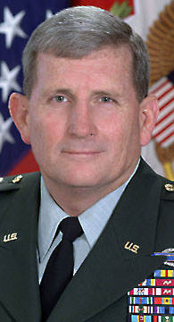
Operation Eagle Claw
What do we know about planning?
“Never confuse enthusiasm with capability”
General Peter Schoomaker
5 October 2021
Asia Pacific Burn Association

Slide 20
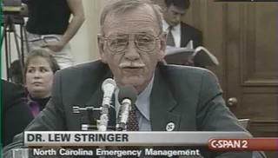
“If you’ve seen one disaster, you’ve seen one disaster. While there are common elements, we can learn from one to help us with the next, competent disaster response requires a strong command of the fundamentals, as well as incident commanders who understand unique situations and can devise creative solutions. Can you adapt and overcome?”
Lew Stringer MD, Senior Medical Advisor FEMA (ret)

Slide 21
“The best thing about not planning is that failure comes as a complete surprise and not preceded by a period of worry and depression.”
(Often stated by Sir John Harvey-Jones) however, may have earlier been said by: John Prescott Ph.D., Boston College

Slide 22
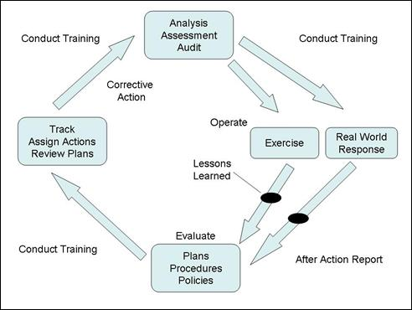

Slide 23
Building a Plan, Resources
All disasters are local
Intrastate resources
Burn Centers (surge capacity)
Trauma Centers (surge capacity)
Transportation resources

Slide 24
Building a Plan, Resources cont.
Interstate resources
Burn Centers (surge capacity)
Trauma Centers (surge capacity)
Transportation resources

Slide 25
Building a Plan, Resources cont.
Interstate (and maybe international) cooperation, common referral patterns, interstate impediments to transfer, nature of the disaster

Slide 26
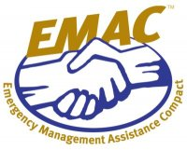
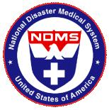
Burn Center Planning
Disaster plans should reflect an extension of daily activities.
Planning from the burn center perspective should reflect (minimally) three levels;
Kearns RD, Conlon KH, Valenta AL, Matherly AF, Holmes 4th JH, Cairns CB, Lord, G, Sawyer D, Johnson II DT, Skarote MB, Siler SM, Helminiak C, Cairns BA. Disaster Planning: The Basics of Creating a Burn Mass Casualty Disaster Plan for a Burn Center. Journal Burn Care Research. Pub Ahead of Print JBCR: Jul 2013.

Slide 27
Burn Center Planning cont.
Local: Intrafacility (your EMS agency/hospital/system)
State: Interfacility/intrastate (burn and trauma centers) (state ESF-8)
Regional/National: Interstate (burn and trauma centers) NDMS or EMAC through state ESF-8
Kearns RD, Conlon KH, Valenta AL, Matherly AF, Holmes 4th JH, Cairns CB, Lord, G, Sawyer D, Johnson II DT, Skarote MB, Siler SM, Helminiak C, Cairns BA. Disaster Planning: The Basics of Creating a Burn Mass Casualty Disaster Plan for a Burn Center. Journal Burn Care Research. Pub Ahead of Print JBCR: Jul 2013.

Slide 28
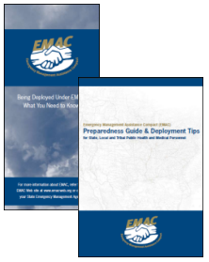
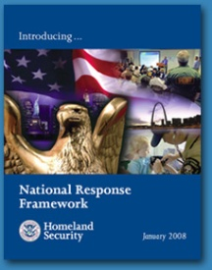
Governmental Planning
Planning from the governmental perspective should reflect:
Local: First Responder (EMS system)
First Receiver(s) (local hospital[s])
State: Mutual Aid EMS, Intrastate regional response teams, burn and trauma centers
Regional: Interstate Burn Centers, Regional or Federal Response Teams through EMAC or NDMS
Kearns RD, Holmes 4th JH, Conlon KH, Valenta AL, Matherly AF, Cairns CB, Lord, G, Sawyer D, Johnson II DT, Skarote MB, Siler SM, Helminiak C, Cairns BA. Disaster Planning: The Basics of Creating a Burn Mass Casualty Disaster Plan for a Burn Center. Journal Burn Care Research. Pub Ahead of Print JBCR: Jul 2013.

Slide 29
Planning Barriers
Local: Facility competition for patients
State: Intrastate tendencies, imaginary barriers at state line
Regional: Lack of interstate cooperation, rules regarding Medicaid coverage versus workman's compensation, geographical limitations (burn care is very expensive, an out of state burn center may not be able to accept patients due to payer source)

Slide 30
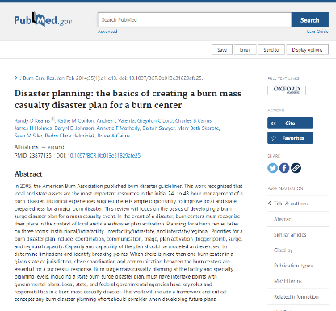
Three Windows in Time, in a Burn Disaster
Immediate: best you can with what you have and know who to call for what you need (also referred to as a No-notice Event)
Kearns RD, Conlon KH, Valenta AL, Matherly AF, Holmes 4th JH, Cairns CB, Lord, G, Sawyer D, Johnson II DT, Skarote MB, Siler SM, Helminiak C, Cairns BA. Disaster Planning: The Basics of Creating a Burn Mass Casualty Disaster Plan for a Burn Center. Journal Burn Care Research. Pub Ahead of Print JBCR: Jul 2013.

Slide 31
Three Windows in Time, in a Burn Disaster cont.
6-120 hrs: leaning forward with response teams, transport agencies, and push packs of equipment (staff, space, stuff)
Kearns RD, Conlon KH, Valenta AL, Matherly AF, Holmes 4th JH, Cairns CB, Lord, G, Sawyer D, Johnson II DT, Skarote MB, Siler SM, Helminiak C, Cairns BA. Disaster Planning: The Basics of Creating a Burn Mass Casualty Disaster Plan for a Burn Center. Journal Burn Care Research. Pub Ahead of Print JBCR: Jul 2013.

Slide 32
Three Windows in Time, in a Burn Disaster cont.
>72-120 hrs: burn centers should strive to return to at least contingency surge capacity by or before H120
Kearns RD, Conlon KH, Valenta AL, Matherly AF, Holmes 4th JH, Cairns CB, Lord, G, Sawyer D, Johnson II DT, Skarote MB, Siler SM, Helminiak C, Cairns BA. Disaster Planning: The Basics of Creating a Burn Mass Casualty Disaster Plan for a Burn Center. Journal Burn Care Research. Pub Ahead of Print JBCR: Jul 2013.

Slide 33
Disaster Plan Triggers
Entry - Activation
“Subject Matter Expert Consensus” (aka “Back of a Napkin approach”)
Data and Assumptions

Slide 34
Disaster Plan Triggers cont.
Activity within the Plan
Modeling
Test: Exercise Tabletop, Functional and Full Scale
Use it

Slide 35
Disaster Plan Triggers cont.
Plan Fatigue/Failure
Plan vs. Framework

Slide 36
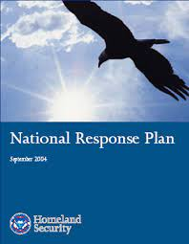
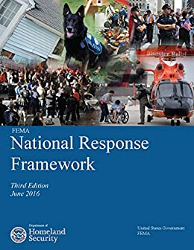
Plans vs Framework
Federal Response Plan 1999 – Discussed much of the federal activities during a presidentially declared disaster in support of local agencies.

Slide 37
Plans vs Framework cont.
National Response Plan 2004 – Represented a new direction, providing more support for local agencies and expanded scope to address in the base plan multiple activities

Slide 38
Plans vs Framework cont.
National Response Framework 2008 – The notice of change stated the update "emerged from organizational changes within DHS, as well as the experience of responding to Hurricanes Katrina, Wilma, and Rita in 2005.”

Slide 39
Plans vs Framework cont.
The plan failed on multiple fronts during Hurricane Katrina. One outcome was to recognize that no plan can address every need or assume every variable. Thus, local activities will continue to plan for events but when the worst happens, and plans fail, the key components (the framework) will be sustained.

Slide 40
Plans vs Framework cont.
The reality is plans will fail at times. Most plans fail because of poor assumptions (failing to plan to evacuate a flooded hospital that was built in a floodplain) rather than being overwhelmed. Identify framework components that should be sustained until equilibrium is restored.

Slide 41
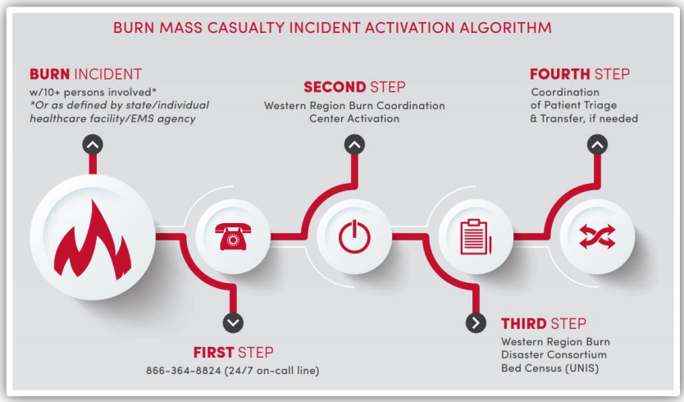
Key Ingredients for a BMCI Plan
All disasters start with a call to 9-1-1. EMS, Fire and other First Responders are the tip of the spear and disaster planning starts there.

Slide 42
Key Ingredients for a BMCI Plan cont.
For EMS systems and hospitals, what are your assets (what you own) and what are your resources (what others can share with you)? Resources will be greatly strained in a BMCI particularly if there is competition for resources or barriers to access those resources

Slide 43
Key Ingredients for a BMCI Plan cont.
Do you have a policy for Crisis Standards of Care vetted by your Ethics Committee?
Do you have agreements in place? Do you regularly exercise together?

Slide 44
Key Ingredients for a BMCI Plan cont.
Do you have an academic partner who can build a model for you? Modeling helps sort out those things probable once you define what is possible. (Typically, modeling costs are far less than actual exercising and allow you to test hypotheticals.)

Slide 45
Key Ingredients for a BMCI Plan cont.
At the scene or at the hospital, the goal is to reach surge equilibrium, the responder/patient balance will assist with moving the surge away from a crisis.

Slide 46
Surge Capacity Definition:
Surge Capacity (and Capability) includes the
Staff
Space
Supplies (Supplies, Pharmaceuticals & Equipment)
required to meet the needs of the patients.
The most important contributing factor outside of S3 is medical transportation resources.

Slide 47
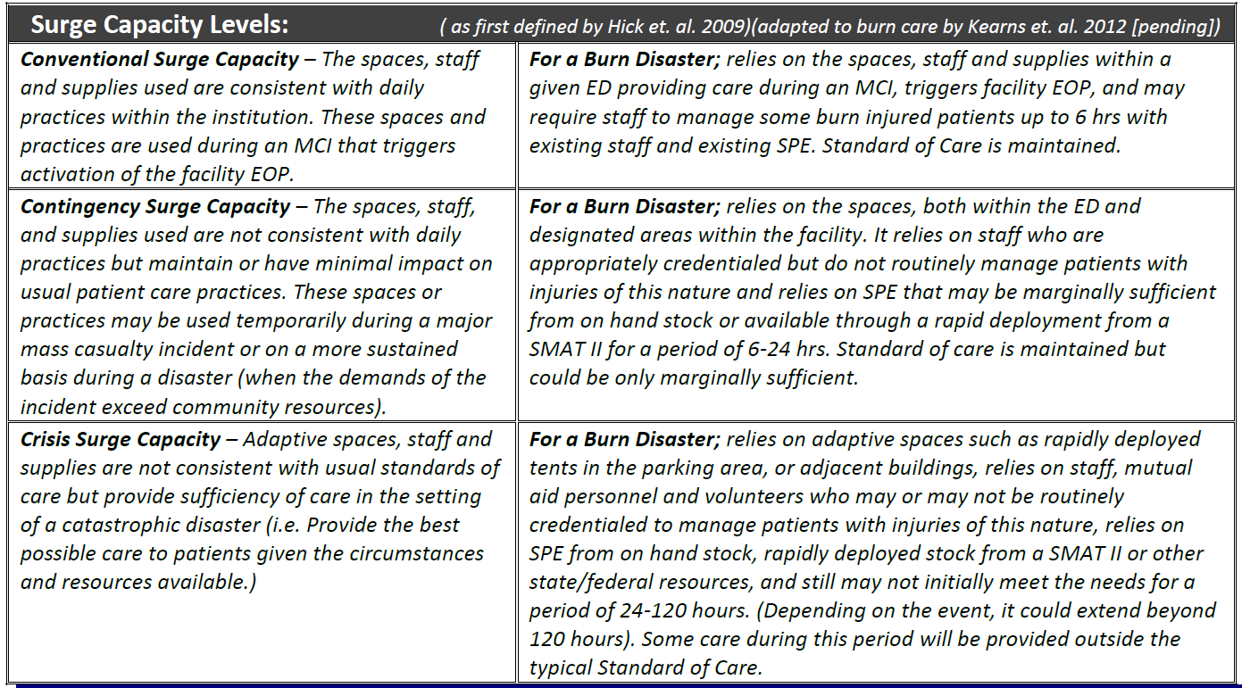
Defining Surge Capacity (3S)

Slide 48
Burn Disaster Planning
99.99%
Day to Day Capacity
Y
Probability
Conventional Surge Capacity
Contingency Surge Capacity
Crisis Surge Capacity
0.01%
Greater >
X
Severity
< Lessor

Slide 49
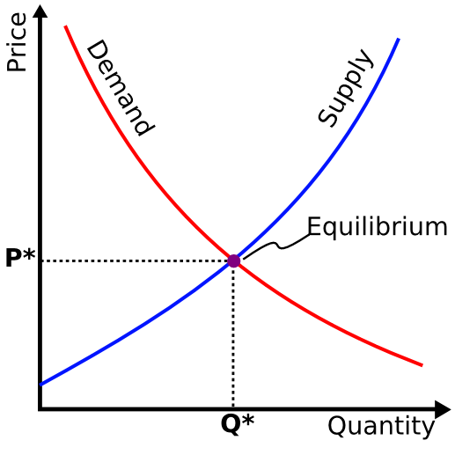
Mathematical Assumptions
Probability is inversely proportional to Capacity Demand (Y axis)
Capacity Demand + Deployment Time = Severity (X axis)
(how long the event takes place)
In economic terms, you would say the American Healthcare Model is based on Static Equilibrium
Intersection point of supply/demand

Slide 50
Burn Disaster Planning
99.99%
Y
Probability
Goal: Return to
Day to Day Capacity
0.01%
Greater >
X
Severity
< Lessor

Slide 51
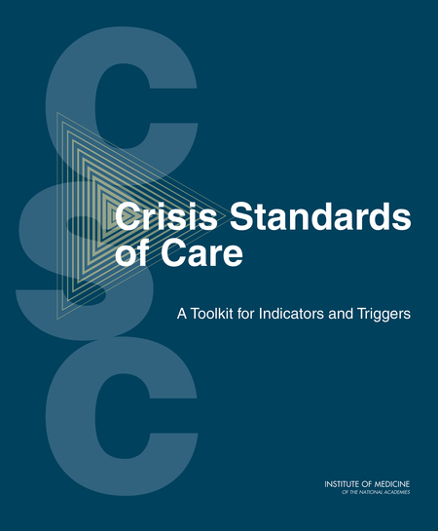
Crisis Surge Capacity
Goal
Take all steps necessary to avoid or end Crisis Surge Capacity as soon as possible

Slide 52
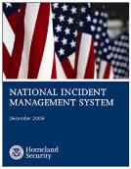
Are you competing for Resources?
Type III Burn Disaster:
Isolated burn disaster such as the Station Night Club Fire
Burn Care System Impact
Kearns RD, Conlon KH, Valenta AL, Holmes 4th JH, Cairns CB, Johnson 2nd D, Matherly AF, Sawyer D, Lord G, Skarote MB, Siler SM, Helminiak C, Cairns BA. Disaster Planning: The Basics of Creating a Burn Mass Casualty Disaster Plan for a Burn Center. Journal Burn Care Research. JBCR: Online July 2013.

Slide 53
Are you competing for Resources?
Type II Burn Disaster:
Multiple aspect disaster, such as an explosion with significant numbers of traumatic as well as burn injured patients such as the 05 London or 04 Madrid Bombings
Healthcare System Impact
Kearns RD, Conlon KH, Valenta AL, Holmes 4th JH, Cairns CB, Johnson 2nd D, Matherly AF, Sawyer D, Lord G, Skarote MB, Siler SM, Helminiak C, Cairns BA. Disaster Planning: The Basics of Creating a Burn Mass Casualty Disaster Plan for a Burn Center. Journal Burn Care Research. JBCR: Online July 2013.

Slide 54
Are you competing for Resources?
Type I Burn Disaster:
Catastrophic/widespread event, multi-state such as 9/11 attacks or Earthquakes such as Northridge or Loma Prieta
Infrastructure Impact
Kearns RD, Conlon KH, Valenta AL, Holmes 4th JH, Cairns CB, Johnson 2nd D, Matherly AF, Sawyer D, Lord G, Skarote MB, Siler SM, Helminiak C, Cairns BA. Disaster Planning: The Basics of Creating a Burn Mass Casualty Disaster Plan for a Burn Center. Journal Burn Care Research. JBCR: Online July 2013.

Slide 55
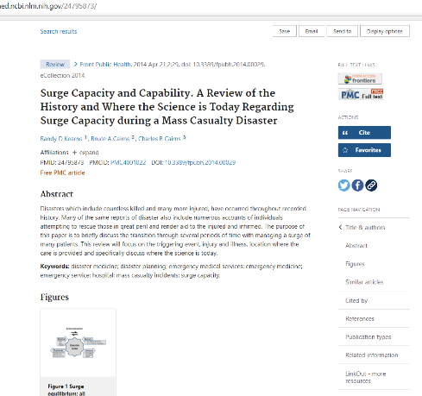
What is your strategy to manage all of the patients either at the scene or at the hospital?

Slide 56
Where are your Burn Centers?
Two Closest Burn Centers to Vermont (from Canada)
University of Montreal Health Centre (CHUM)
Montreal Children's Hospital
Seven Closest Burn Centers to Vermont
University of Vermont Burn Center
Maine Medical Center
University of Massachusetts Memorial
Brigham and Women’s Hospital Burn Center
Shriners Hospitals for Children – Boston
Sumner Redstone Burn Center
Rhode Island Hospital Burn Center
(Red dots denote Verified Burn Center, black dots denote Self-Identified Burn Center)

Slide 57
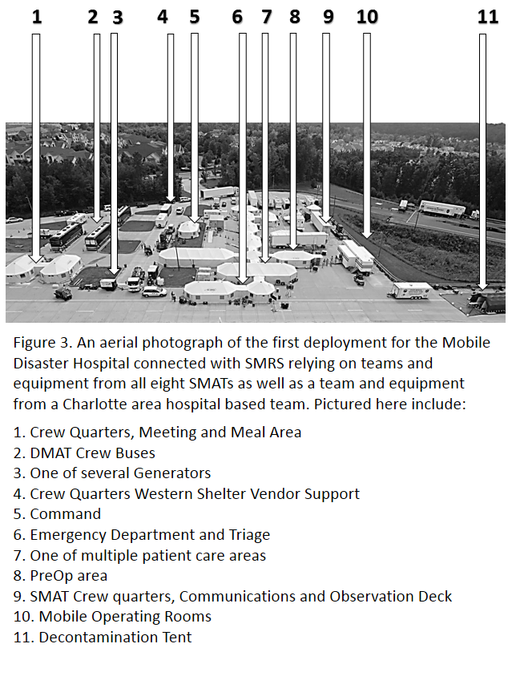
Where are the mobile field hospitals?
Do you have a state version of the DMAT? (SMAT or some similar program?)
Does a neighboring state have that/those resource(s)?
How do you access a DMAT team?
Under what circumstances would you need one of these teams?

Slide 58
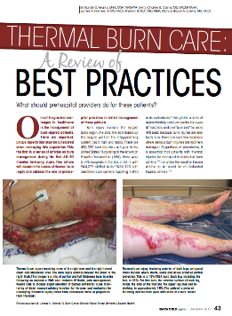
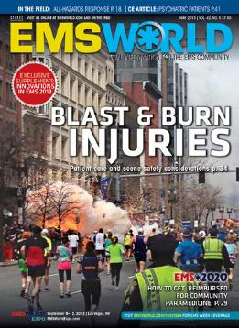
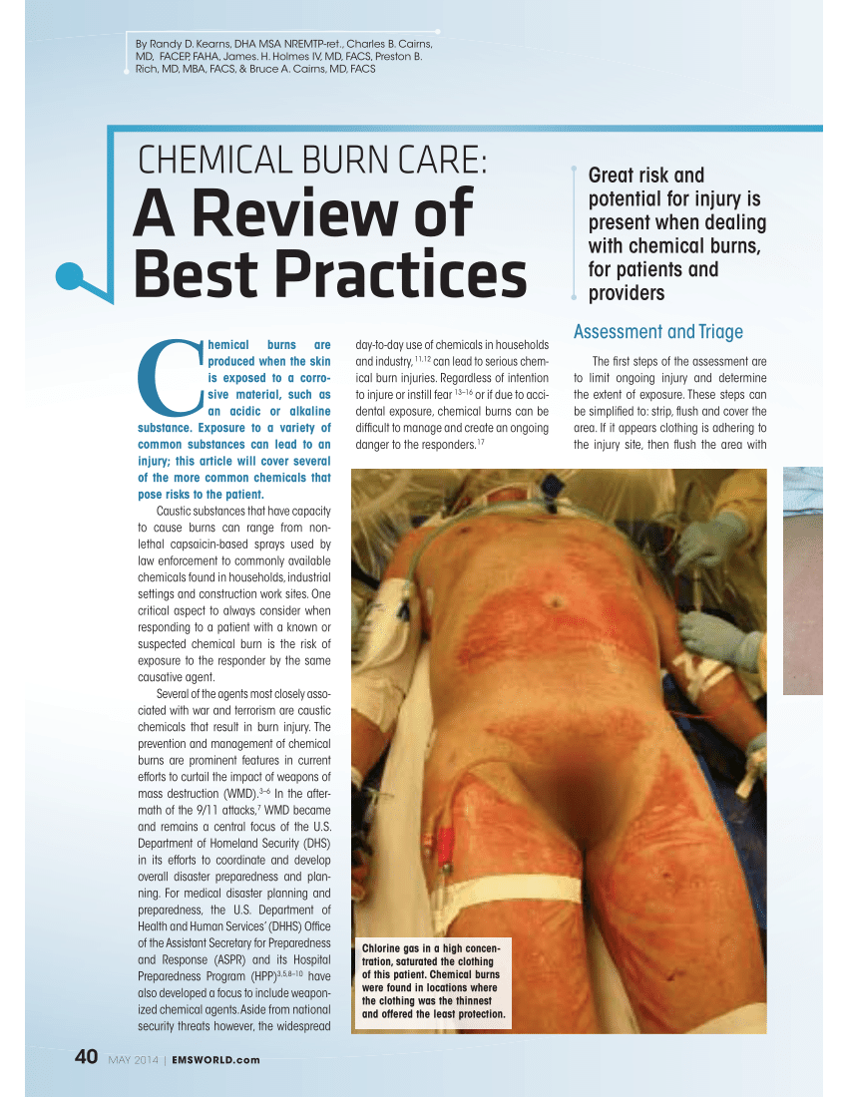
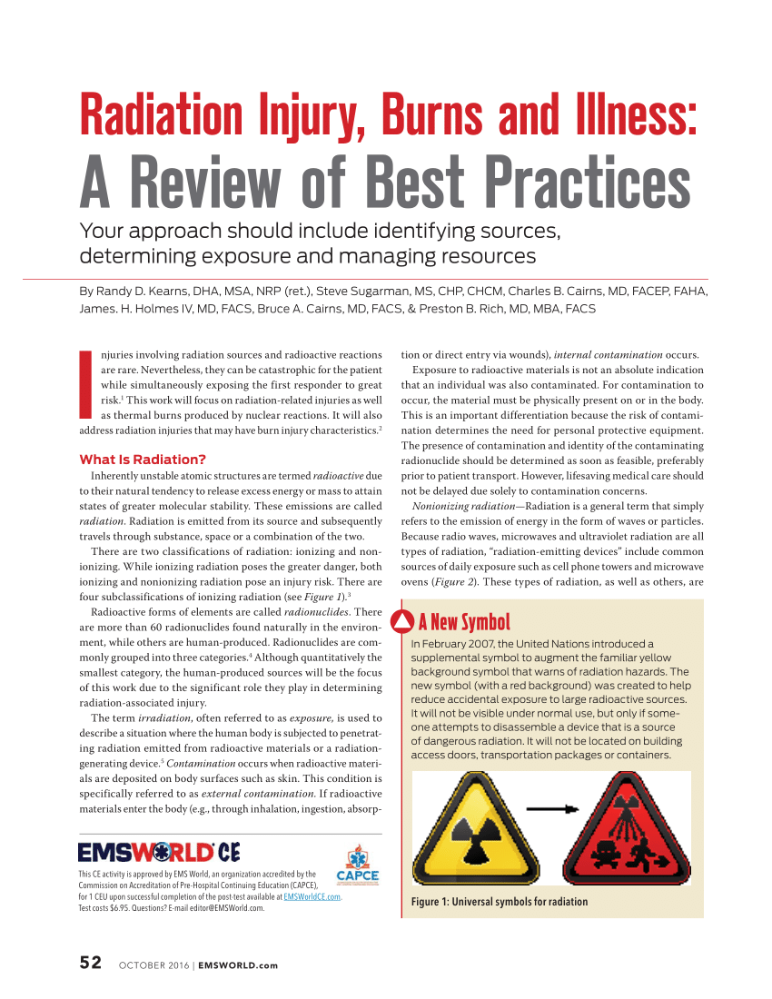
Led to Increase contributions to Education and Training
Is your education for the care of one burn patient current? It’s difficult to care for many if you struggle with one.
How often do you train with your mutual aid partners?
Do you enjoy other activities together? Share a meal?
Do you trust your mutual aid partners will be there when needed? During an MCI is not the time to find out.

Slide 59
Historical Events can give us insight into patient volumes
Station Nightclub Fire
Coconut Grove Fire
MGM Grand Hotel Fire
Industrial Plant Explosions
Terrorism? We have experiences in the US but the country that relies on similar medical practice standards as well as disaster planning is Israel. What can we learn from the Israelis about terrorism?

Slide 60
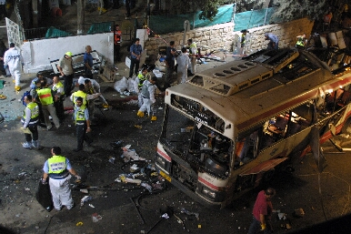
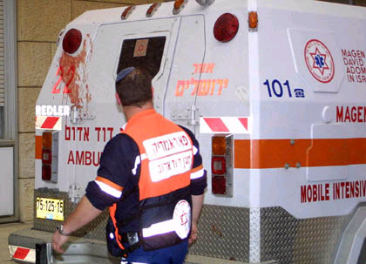
Predicting Victims
Review of 33 suicidal bombings in Israel
Oct 2000 to Aug 2002, involving 6 or more causalities
Average of 57 victims/incident
killed or wounded; range: 6 to 145 victims
Notes:
These as yet unpublished figures were compiled by Jim Crabtree, RN Los Angeles County EMS agency. While they are certainly in need of further study the ratios have been found to be fairly consistent with published reports of other bombings. The difficulty with these figures is that the numbers were drawn from ‘newspaper’ accounts. It has been seen that these numbers are not 100% consistent especially in the areas of reporting the number of wounded. The number of deaths from a particular incident are the same when comparing different sources but the number of “injured” varies. There is no specific definition for “injured” in the press. Despite being inaccurate they are consistent with known information about the ratios of killed to wounded overall.

Slide 61
Predicting Victims
Mass casualty event - blast victim reception
Expect two waves of victims at hospitals
Self transport
EMS transport
Don’t move hospital resources to scene!
Expect ½ (half) of victims to arrive in first hour
(Double first hour number to arrive at total)
Most injuries will be non-fatal
The surge will be among minor patients, NOT critical
Notes:
Terrorist bombings are intended to produce casualties among people. Their placement and time of detonation can therefore be expected to occur during periods when a location is occupied. In most situations, this would mean a daytime bombing, however bombings at nightclubs or restaurants have occurred in the evening and night time hours. A terrorist bombing will always be an unexpected event. Even when warnings have been given to authorities, it is unlikely that health care responders would be informed until after the blast has actually happened. The resultant effect upon the health care emergency system is the creation of a mass casualty event. Previous terrorist bombings have resulted in just 1 or 2 victims all the way up to the 759 persons involved in the 1995 Oklahoma City explosion.
The priorities are; scene control (including safety), interfacing with law enforcement, triage at the scene, triage at the hospital, management of available health care resources (treatment, admission beds, access to special procedures) and identification and release of fatalities.
After the Oklahoma City bombing it was noted that victims arrived in two different “waves”. First the “self transported” followed by the Ambulance transported. (ED Management 2000) Again, with the least injured arriving first. This can be a factor to remember in not tying up resources treating this first group.

Slide 62
An Example of How to Model Surge Capacity
We’ve mentioned modeling several times, let’s look at how it applies to disaster research
We will start with a “research question”
And then look at an example of using Monte Carlo Simulation to help us understand the capacity for a state and a region
As previously mentioned, Historical Events can give us insight into patient volumes

Slide 63
A Good Question Starts with a Known or Perceived Need
Historical Vermont disasters Regional disasters in New England, National Disasters
Current threats
9/11 attacks redefined our n for “bad”
Burn Centers are scarce medical resources, Vermont has one
Current threats and historical events suggest need for ongoing disaster preparedness
Intrastate resources
Interstate resources

Slide 64
Modeling
The Value of Modeling:
Test multiple hypotheses
Inject variability
Provides substantial feedback without the expense of exercises (while exercises have substantial value on many levels, they are also costly)
Three Types of Simulation
Discrete Event
Continuous
Monte Carlo
Plan Fatigue/Failure
Plan vs. Framework

Slide 65
Monte Carlo Simulation
Computational algorithms
Rely on repeated random sampling to yield results
Census and Admissions
Define possible inputs
Frequency distribution (Normal Distribution, determined by the Home Hospital Data)
Deterministic computation
Probabilistic values for bed availability
Aggregate results
Compounding variable, number of hospitals
Von Neumann, Ulam, Metropolis
1940’s at Los Alamos, probability that nuclear weapons would work

Slide 66
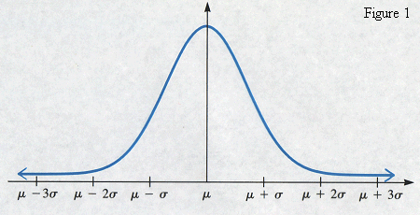
Key Inputs
Distribution Curve (normal)
Data from representative burn center
Assumes 150% surge (ABA standard)
Coefficient of variation
Average Daily Census/Standard Deviation
X = Simulations (X1-X10)
X1-X5 Real events, assumes all burn injured need burn beds
X6-X10 Theoretical Patient Inputs
Y = Hospitals/States/Balance of the Region
Hospitals (Intrastate) Y1, Y2
States (Interstate) Y3, Y4, Y5
Balance of the Region Y6

Slide 67
Model
Determine number of beds needed (expressed as X) input parameter
Test with historical data
Compare X to available beds at Home Hospital (expressed as Y1)
X < Y1 then stop, if X > Y1 then add in neighboring hospital in-state Y2
If (Y1+Y2) > X then stop, if X > (Y1+Y2) then proceed
Simulations X1 – 54 patients X2 – 130 patients X3 – 38 patients X4 – 215 patients X5 – 243 patients X6 – 500 patients X7 – 1,000 patients X8 – 2,500 patients X9 – 5,000 patients X10 – 10,000 patients | ESF-8 Approach, Hospitals/State Burn Center Resources Y1 Home hospital (Burn Center) Y2 Intrastate resources (2 Burn Centers) Y3 Virginia state resources – 4 Burn Centers Y4 Georgia state resources – 2 Burn Centers Y5 Tennessee state resources – 2 Burn Centers Y6 Remainder of Southern Regional Burn Centers

Slide 68
Results
Confirmed Trigger points for planning tools
Activation points for transportation assets/resources
Better understanding of capacities and capabilities
6:5:6 Trigger to activate Plan
20-60 patients = Intrastate Plan Failure (variability depends on patient acuity and availability)
425-450 patients = Interstate Plan Failure (Regional)

Slide 69
Key Steps at the Scene
Modeling helps us predict:
Trigger points
Sufficient Resources
to the scene to care for and move patients to appropriate destinations
Upstream notification
Receiving hospitals
Mutual aid ground/air ambulances
Capacity, Capability, Transportation
Kearns RD, Hubble, MW, Holmes 4th JH, Cairns BA. Disaster Planning: Transportation Resources and Considerations for Managing a Burn Disaster. Journal Burn Care Research JBCR: Jun 2013.

Slide 70
Planning or Modeling?
Modeling can be helpful and informative, but nothing replaces sound strategic planning
We’ve discussed the importance of surge components; staff, space and supplies
We have also discussed how your daily activities will influence your disaster response
We will conclude with two often overlooked or underappreciated components of a disaster plan; transportation resources and the role finance plays in a disaster

Slide 71
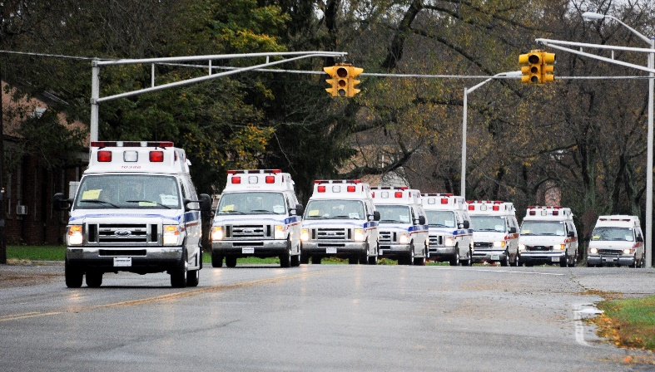
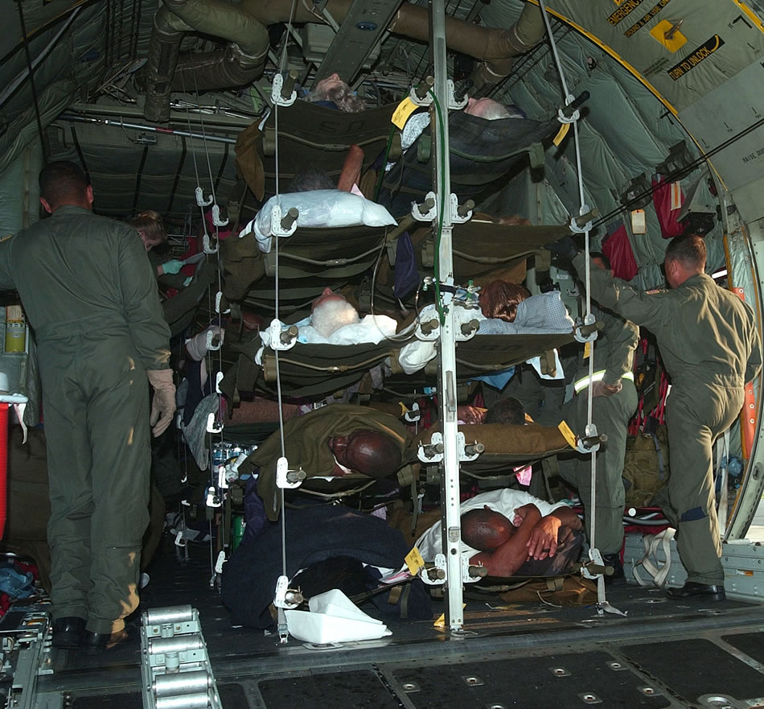
Transportation Resources Who has these resources? How do you access them? What is the process? Will they help you?
Civilian
Ambulances –
Ambulance Strike Teams –
AmBuses Units –
SCT/CCT Units –
Helicopters –
Fixed Wing –
Governmental or Military
National Guard vs. Reserves or Regular Air Force
Coast Guard, Forest Service, Park Service

Slide 72
Finance
Few injuries rival the costs of burn care. Interstate transfers may be hampered due to payer source.
Reimbursement Possibilities
Traditional
HHS/NDMS
1135 Waiver
FEMA (Stafford Act)
Preparedness Investment (Costs)

Slide 73
Conclusion
Hope is not a substitution for disaster planning/preparedness
Shame/fear factor is not a substitution for understanding the need
Effective Plans Require Effective Relationships with your Partners
Local, State, Regional Resources are all important
Who to call and what can you bring?
Staff, Space, Supplies – Transport resources and the role Finance Plays
Plans – Scalability, Trigger Points, Activity, What do you do when your plan Fails?
All disasters are local, so are all solutions
Education = Comfort and Competence

Slide 74
5 Things from this module
Disaster plans should be an extension of what you do every day.
All disasters are local. After the disaster in your community is over, mutual aid will return home, but it is still your community.
BMCI and MCI planning share similar components with one distinct difference. For the best outcomes, burn injuries require specialty care.
What are your assets and what resources will others share with you? (mutual aid)
Don’t overlook the role finance plays in your planning process.

Slide 75
Thank You.
rkearns@uno.edu

Slide 76
References
1. Committee on Crisis Standards of Care ATfI, Triggers, Board on Health Sciences P, Institute of M. In: Hanfling D, Hick JL, Stroud C, eds. Crisis Standards of Care: A Toolkit for Indicators and Triggers. Washington (DC): National Academies Press (US). Copyright 2013 by the National Academy of Sciences. All rights reserved.; 2013.
2. Saffle JR, Gibran N, Jordan M. Defining the ratio of outcomes to resources for triage of burn patients in mass casualties. J Burn Care Rehabil. 2005;26(6):478-482.
3. Taylor S, Jeng J, Saffle JR, Sen S, Greenhalgh DG, Palmieri TL. Redefining the outcomes to resources ratio for burn patient triage in a mass casualty. J Burn Care Res. 2014;35(1):41-45.
4. Tompkins RG. Survival from burns in the new millennium: 70 years' experience from a single institution. Annals of surgery. 2015;261(2):263-268.
5. Goverman J, Mathews K, Nadler D, et al. Satisfaction with life after burn: A Burn Model System National Database Study. Burns : journal of the International Society for Burn Injuries. 2016;42(5):1067-1073.
6. National Academies of Sciences E, Medicine. A National Trauma Care System: Integrating Military and Civilian Trauma Systems to Achieve Zero Preventable Deaths After Injury. Washington, DC: The National Academies Press; 2016.
7. Wachtel TL, Cowan ML, Reardon JD. Developing a regional and national burn disaster response. J Burn Care Rehabil. 1989;10(6):561-567.
8. Gamelli RL, Purdue GF, Greenhalgh DG, et al. Disaster Management and the ABA Plan. J Burn Care Rehabil. 2005;26(2):102-106.
9. Barillo DJ, Dimick AR, Cairns BA, Hardin WD, Acker JE, 3rd, Peck MD. The Southern Region burn disaster plan. J Burn Care Res. 2006;27(5):589-595.
10. Kearns R, Holmes Jt, Cairns B. Burn disaster preparedness and the southern region of the United States. Southern medical journal. 2013;106(1):69-73.
11. Petinaux B, Valenta AL, Deatley C, Conlon KM, Ott JD, Jeng JC. District of Columbia Emergency Healthcare Coalition Burn Mass Casualty Plan: Development to Exercise Date. J Burn Care Res. 2017;38(1):e299-e305.
12. Yurt RW, Lazar EJ, Leahy NE, et al. Burn disaster response planning: an urban region's approach. J Burn Care Res. 2008;29(1):158-165.
13. Leahy NE, Yurt RW, Lazar EJ, et al. Burn disaster response planning in New York City: updated recommendations for best practices. J Burn Care Res. 2012;33(5):587-594.
14. Conlon KM, Ruhren C, Johansen S, et al. Developing and implementing a plan for large-scale burn disaster response in New Jersey. J Burn Care Res. 2014;35(1):e14-20.

Slide 77
Historical Recap
Take away points – What can you discuss in terms of your jurisdiction?
Governmental Planning – Have you engaged your local, state, federal partners?
Time Components – What time factors can be addressed with technology, different transportation resources
Plan Activation/Failure – based on your situation, what activates your plan or causes it to fail?

Slide 78
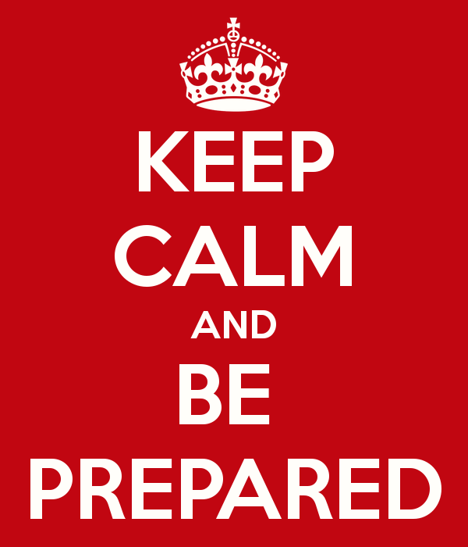
Questions?

Slide 79
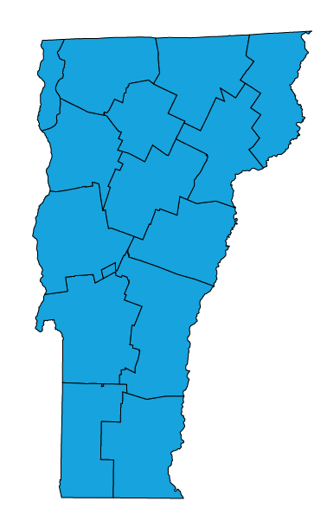
Content for this Presentation was Created or Developed by Randy Kearns for All Clear Emergency Management Group to be used for the State of Vermont
Dr. Kearns began his career as a paramedic, rescue chief and firefighter and instructor. Over 30 years, he taught emergency services programs at several community colleges in the Carolinas, spent 8 years in hospital administration and led multiple emergency service and emergency management organizations. Dr. Kearns has been a responder to 25+ presidentially declared disasters as a local, state and federal representative. In 2014, Dr. Kearns retired (from the State of North Carolina) as a Clinical Assistant Professor at the University of North Carolina, School of Medicine. After spending four years as the Healthcare Management Program Chair and an Associate Professor at the University of Mount Olive, Dr. Kearns joined the faculty here at the University of New Orleans in the College of Business Administration, August 2018.
Publication Indexes: PubMed Scopus ResearchGate ORCID
Dr. Kearns has 81 publications in various forms. And, according to Expertscape (www.expertscape.com an academic artificial intelligence analysis software) is ranked 4rd internationally for research in “Surge Capacity” 5th internationally for research in “Mass Casualty Incidents” and 11th for his work in “Disaster Planning.”
All Clear Emergency Management Group, LLC is an experienced consulting firm that provides an array of emergency management services and conference management services. Our team of dedicated professionals will exceed our clients’ expectations.

Slide 80
Assignment of Rights
This content was developed for the All Clear Emergency Management Group for use with the State of Vermont.
Content used for this presentation, where applicable, has been sourced from various public documents or from the author’s personal materials. Copyright for papers published in academic journals, in their final form, are maintained by those respective journals.
The purpose of this project is to provide education for those involved in emergency care for those with a burn injury. Reuse of this material in their current format is restricted to All Clear Emergency Management Group for use with the State of Vermont.
All other rights to the materials are retained by the author.

Slide 81
Fair Use and Disclaimer
Images and other content found throughout this presentation are either cited for their original source, are owned by the author of this work or were commonly found on the world wide web and not identified as being protected images (copyright). These images and this content are used and protected based on the Fair Use Doctrine.
Copyright Disclaimer Under Section 107 of the Copyright Act 1976, allowance is made for "fair use" for purposes such as criticism, comment, news reporting, teaching, scholarship, and research. Fair use is a use permitted by copyright statute that might otherwise be infringing. Non-profit, educational or personal use tips the balance in favor of fair use.
If for any reason you see an image that may in fact be copyrighted or you find objectionable, please notify us immediately.

